Slide 1
Maximize Performance Using Read Committed Snapshot Isolation
Haripriya Naidu
She/Her
Database Administrator
SQL Sat Boston 9/27/25

Slide 2












Slide 3




Haripriya Naidu
SQL Database Administrator
11 years
AWS Certified Solutions Architect
Speaker
Blogger
New Stars of Data 2024
gohigh.substack.com
linkedin.com/in/haripriya-naidu1215/
github.com/haripriyasb/RCSI

Slide 4

Problem I needed to solve

Slide 5
Agenda
Read Committed and its problems
Read Committed Snapshot Isolation
How it works and its benefits
Version Store
Tradeoffs

Slide 6

Isolation
Concurrently running transactions shouldn’t interfere with each other
Example:
Two people editing the same document.
Without isolation, one person might see the other’s half-finished sentences.

Slide 7
Isolation Levels
Locking model
Locking & Row Versioning model
Read Uncommitted
Read Committed
Repeatable Read
Serializable
Read Committed Snapshot
Snapshot

Slide 8
What is Read Committed
Default isolation level
It makes two guarantees:
1. No dirty reads – read only committed data
2. No dirty writes – overwrite only on committed data
Notes:
When reading from the database, you will only see data that has been committed (no dirty reads).
When writing to the database, you will only overwrite data that has been committed (no dirty writes).
Second write is delayed until the first write’s transaction has committed or aborted

Slide 9
Problems with Read Committed
SELECT * FROM dbo.Orders
UPDATE dbo.Orders SET id =1
Orders table
Acquires Shared(S) lock
Waits for Exclusive(X) lock
Read vs Write blocking
Write operations are blocked when read is going on
OR
Read operations are blocked when write is going on

Slide 10
To resolve this
Optimize queries
Keep transactions short
Add indexes but not cause too much overhead
Read Committed Snapshot Isolation level

Slide 11
Read Committed Snapshot Isolation

Slide 12
What is Read Committed Snapshot Isolation(RCSI)
Row versioning-based isolation level
UPDATE/DELETE operations:
Make a copy of previously committed data to tempdb
Read operations
No Shared(S) lock
Read data from snapshot in TempDB
Write happens on the original table
No read/write blocking
INSERT statements don’t need to be versioned

Slide 13

What is Read Committed Snapshot Isolation(RCSI)
If read operation comes in first
If write operation comes in first
SELECT * FROM dbo.Orders;
Tempdb
Version Store
SELECT * FROM dbo.Orders;
Tempdb
Version Store
NO Shared(S) lock
Not blocked, reads from version store
Copy of Orders rows is made
Before update runs, copy of Orders rows is made
Orders table
Orders table
UPDATE dbo.Orders SET id =1;
Not blocked, gets X lock
UPDATE dbo.Orders SET id =1;
Gets X lock

Slide 14

In short..
User DB
Write
No read vs write blocking
Read
Version Store - TempDB

Slide 15
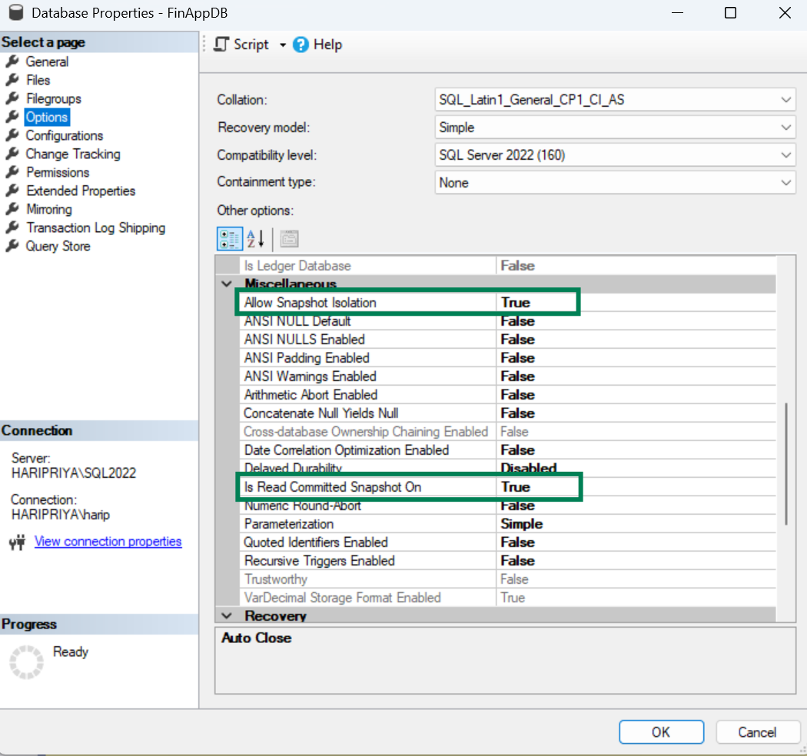
Enable RCSI
Default is OFF
Enable both options

Slide 16
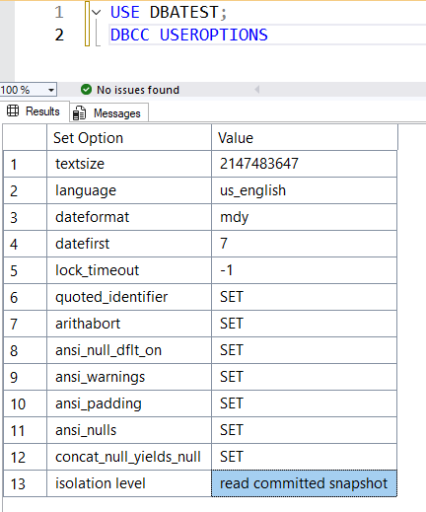
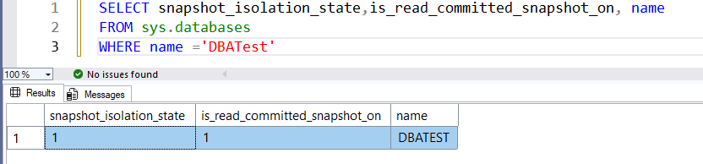
Verify RCSI is enabled

Slide 17
When to Use RCSI
Use RCSI when read/write blocking is the main problem
Best for:
High-concurrency OLTP servers
A lot of read queries reading live data
Servers that have frequent read/write blocking
Optimistic Locking Model or MVCC(Multi Version Concurrency Control)
Default isolation level in Azure SQL
Notes:
maintains several versions of an object side by side, this technique is known as multi version concurrency control (MVCC).

Slide 18
Who blocks who
Locking behavior remains the same for write operations
Blocking still exists between write operations
Only the locking behavior of read operations change
Reads don’t block writes
Writes don’t block reads
Writes block writes

Slide 19
Who blocks who
Read Committed | Read | Write
Read | Doesn’t block | Blocks
Write | Blocks | Blocks
Read Committed Snapshot | Read | Write
Read | Doesn’t block | Doesn’t block
Write | Doesn’t block | Blocks

Slide 20
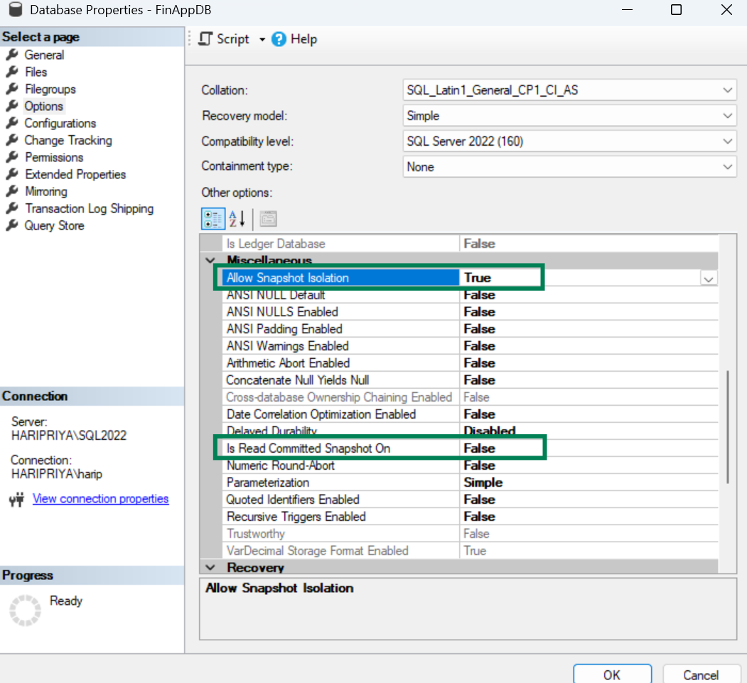
Snapshot Isolation
Only queries with set transaction isolation level can access the version store
SET TRANSACTION ISOLATION LEVEL SNAPSHOT;

Slide 21
RCSI vs SI
RCSI | SI
Enable both options | Enable one option
No code changes | Code changes
Automatically read from version store | Set transaction isolation level
Statement consistent | Transaction consistent

Slide 22
In simple words
Read Committed
read committed data from the table
Read Committed Snapshot
read committed data from the snapshot
Snapshot Isolation
read committed data from the snapshot only when explicitly set
Notes:
RCSI SI optimistic cos readers writes don’t block each other

Slide 23

Version Store

Slide 24
Version Store
Previously committed data in tempdb → row version
Original row gets a 14-byte pointer to row version
Update/Delete → copy data to version store
Versions cleaned up when no active transactions need them
Notes:
Old version = previously committed data
Used by:
Update/delete operations under RCSI
Online index operations, triggers, MARS
SQL Server stores old versions of rows in a special part of tempdb When update/delete operations run, they copy data from original table to version store in tempdb Original rows in the table are modified with 14-byte pointer to reference the old version in tempdb When active transactions finish and no transactions are using VS records, then old versions are removed

Slide 25
How Row Versioning Works Internally
dbo.t1
ID | Letter
1 | A
2 | B
3
TempDB
Row copy
Version Store
Z
14-byte pointer
C
Internal objects
UPDATE dbo.t1
SET letter=‘Z’
WHERE ID=3
Work tables
…

Slide 26

Issue with Version Store
Uncommitted transaction → Tempdb datafile space fill up

Slide 27


Slide 28




Assume: One-way, single lane road, red car driver is sleeping.
First 3 cars left.
Cars behind red car can’t move.
They can’t be freed up.

Slide 29

Version Store Cleanup
Cleanup task runs
3 transactions get cleaned up
7GB released
9:00 Transaction 1 – committed, 2GB - StackOverflow
9:01 Transaction 2 – committed, 2GB - AdventureWorks
9:02 Transaction 3 – committed, 3GB - WorldWideImporters
9:03 Transaction 4 – sleeping , not committed, 2 GB - WorldWideImporters
9:04 Transaction 5 – committed, 2GB - AdventureWorks
9:05 Transaction 6 – committed, 3GB - StackOverflow
9:06 Transaction 7 – committed, 2GB - AdventureWorks
9:07 Transaction 8 – committed, 1GB - WorldWideImporters
……Transaction 25 – committed, 20GB - StackOverflow
……Transaction 70 – committed, 80GB - AdventureWorks
……Transaction 95 – committed, 100GB - AdventureWorks
TempDB gets filled up and server becomes inaccessible
Can’t be cleaned up
10GB is held
Still can’t be cleaned up
Notes:
Could be from any different databases

Slide 30
Monitoring and Troubleshooting
sys.dm_tran_version_store_space_usage
sys.dm_tran_active_snapshot_database_transactions
sys.dm_tran_version_store
Check space used by version store in TempDB
Setup a job to send notification when it exceeds 50% of TempDB size
Link to GitHub - https://github.com/haripriyasb/RCSI

Slide 31
Tradeoffs
Highly volatile systems:
Heavy tempdb usage → tempdb size
Additional CPU and I/O load:
Overhead during data modification and retrieval
Storage
14 bytes increase in row size remains even after records are removed from version store

Slide 32
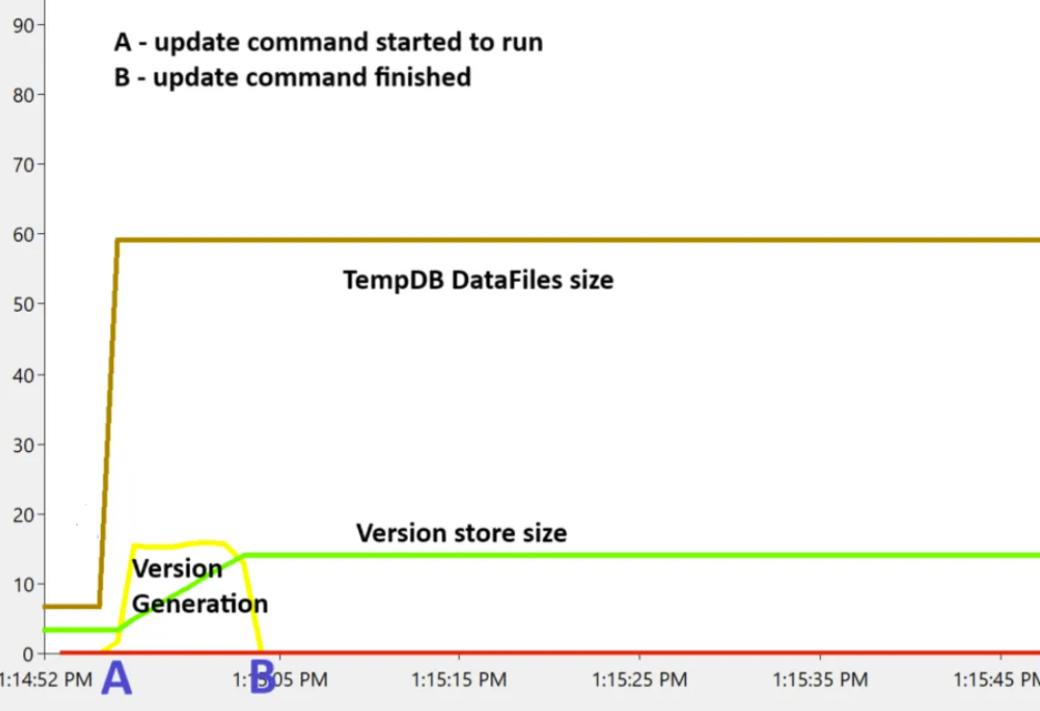
Version Store - Rows Generation

Slide 33
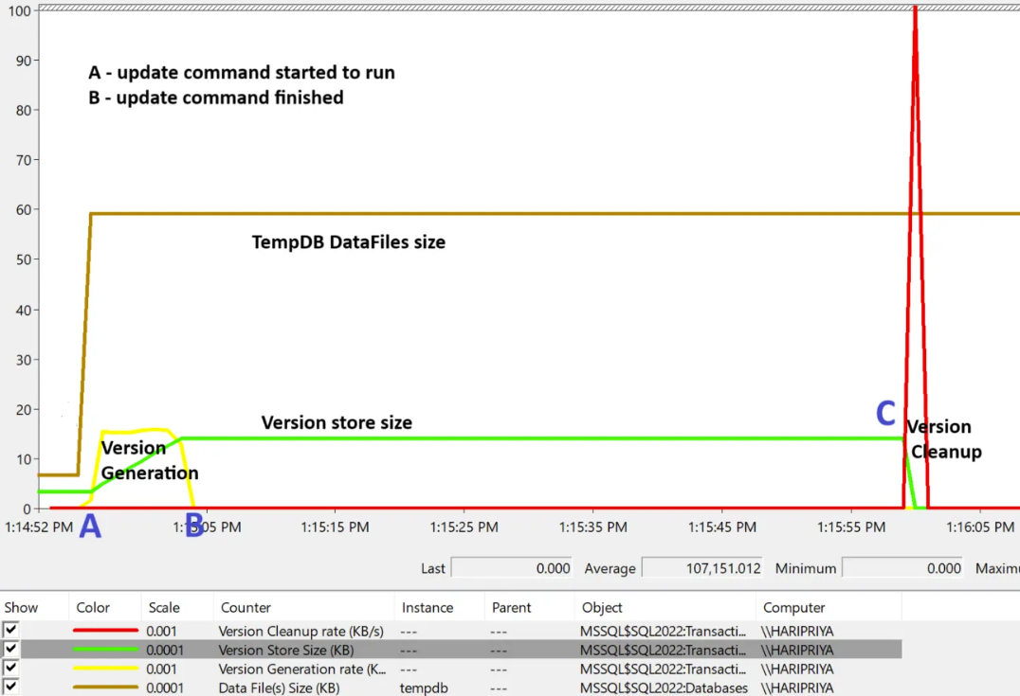
Version Store - Cleanup

Slide 34
Cleanup happens every minute
Hung transaction holds cleanup
Redo this below, based on TID order, graphic
9:00 Transaction 1 – sleeping , not committed, 2 GB
9:01 Transaction 2 – committed, 2GB
9:02 Transaction 3 – committed, 3GB
9:03 Transaction 4 – committed, 2GB
9:04 Transaction 5 – committed, 1 GB
Version store cleanup runs
but cannot cleanup due to the earliest transaction still uncommitted
10GB is held without releasing

Slide 35
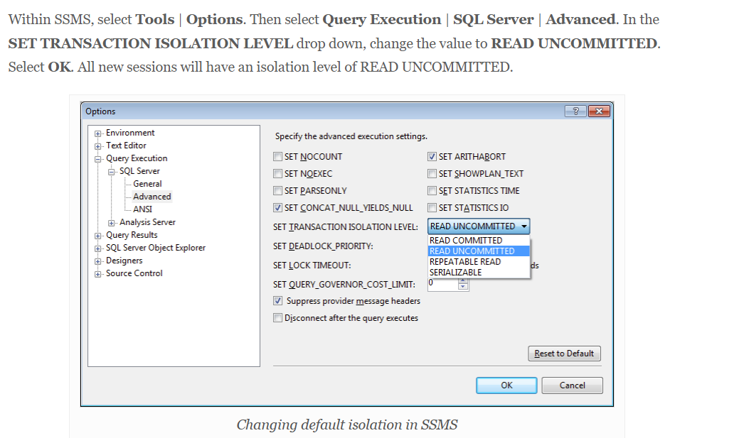
RCSI vs SI
When to choose RCSI vs SI
What does this do - SET TRANSACTION ISOLATION LEVEL SNAPSHOT
IMPLICIT_TRANSACTIONS ON – if this is the case, locks are going to be held for a longer time
http://erinstellato.com/2012/03/isolation-levels-effects-on-select-statements/
read committed snapshot isolation level cannot be set by SET TRANSACTION ISOLATION LEVEL statement for a connection

Slide 36
https://learn.microsoft.com/en-us/previous-versions/tn-archive/cc546518(v=technet.10)?redirectedfrom=MSDN
SQL Server uses locks stored in memory as a way to solve concurrency problems.
The lock types acquired by SQL Server depends on the active transaction isolation level.
All isolation levels always issue exclusive locks for write operations and hold the locks for the entire duration of the transaction.
There are several concurrency problems that can occur in a database management system when multiple users access the same data. – lost update ,repeatable reads, dirty read, phantom read

Slide 37

NOLOCK

Slide 38
Everyone’s “Favorite” Hint
SELECT * FROM dbo.Table WITH (NOLOCK)
No shared lock
Dirty reads
NOLOCK = Read Uncommitted Isolation Level
NOLOCK table hint overrides RCSI or SI
No performance benefit
Notes:
Introduces skipped or duplicate rows, and non-repeatable reads

Slide 39


Choose when to use NOLOCK
NOLOCK
NOLOCK
Archived data
100% accuracy isn’t required
Accuracy is critical
Financial data
Critical reports
OLTP tables
Use RCSI
Notes:
Ad-hoc reporting queries
Large analytical scans

Slide 40
DEMO

Slide 41
Key Takeaways
Use RCSI to solve read vs write blocking
Locking behavior for writes remain the same
TempDB size increases due to version store build up
Watch for long open transaction
Don’t use NOLOCK unless accuracy is not needed

Slide 42
Questions?
gohigh.substack.com
linkedin.com/in/haripriya-naidu1215/
https://github.com/haripriyasb/RCSI
Thank You!

Slide 43


Session Evaluation Win 6x$50 gift card
Event Evaluation Win $100 gift card

Slide 44
Nolock – brent demo – rebuild index
RCSI – no need of index rebuild – brent post

